Slide 1
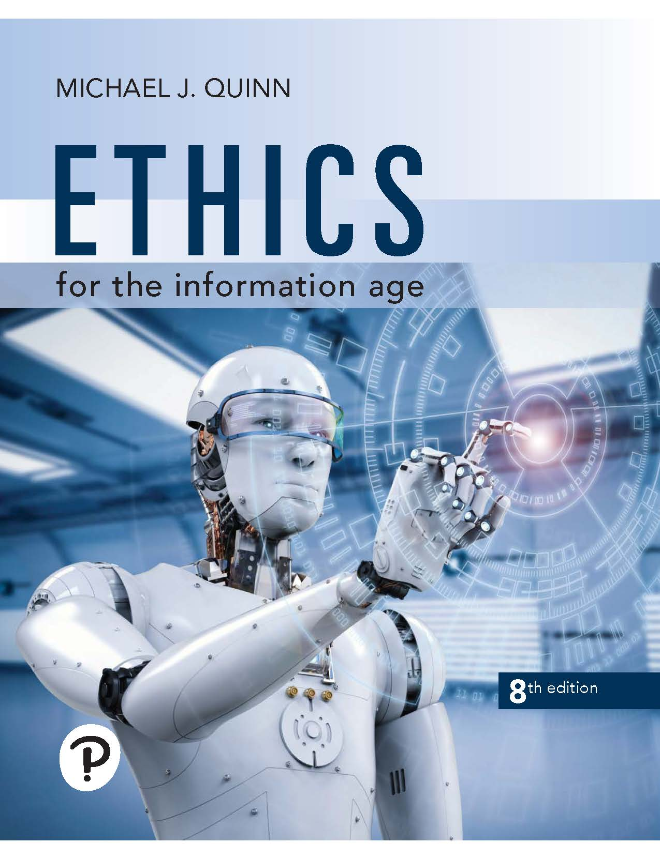
Ethics for the Information Age
Eighth Edition
Chapter 10
Work and Wealth
Copyright © 2020, 2017, 2015 Pearson Education, Inc. All Rights Reserved
Notes:
If this PowerPoint presentation contains mathematical equations, you may need to check that your computer has the following installed:
1) MathType Plugin
2) Math Player (free versions available)
3) NVDA Reader (free versions available)

Slide 2
Learning Objectives
10.1 Introduction
10.2 Automation and employment
10.3 Workplace changes
10.4 Globalization
10.5 The digital divide
10.6 The “winner-take-all society”

Slide 3
10.1 Introduction

Slide 4
10.1 Introduction
Information technology and automation affecting workplace
Increases in productivity
Job creation and destruction
Globalization of job market
Organization of companies
Telework
Workplace monitoring
Impacts of information technology on society
Digital divide
Winner-take-all effects

Slide 5
10.2 Automation and Employment

Slide 6
Automation and Job Destruction
Between 1979 and 2011…
U.S. population increased 39%
Manufacturing employment dropped 40%, from 19.4 million jobs to 11.7 million jobs
Lost white-collar jobs
Secretarial and clerical positions
Accountants and bookkeepers
Middle managers
Juliet Schor: Work week got longer between 1979 and 1990

Slide 7
Lost Manufacturing Jobs
General Motors exited bankruptcy in 2009 with 30 percent fewer employees. (Danny Lehman/Encyclopedia Corbis)

Slide 8
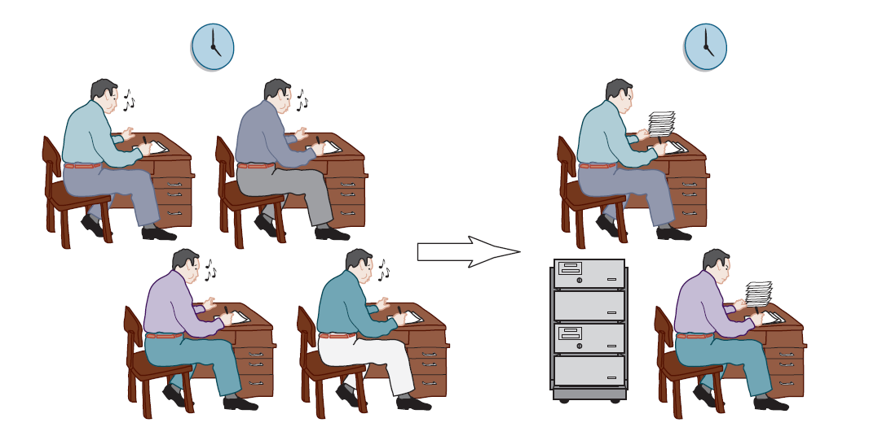
Impact of Layoffs on Workers
When jobs are lost to automation or the introduction of information technology, the remaining workers may work harder in order to avoid being part of the next layoff.

Slide 9
Automation and Job Creation
Automation lowers prices
That increases demand for the product
It also increases real incomes, increasing demand for other products, which means more jobs for people making those products
Number of manufacturing jobs worldwide is increasing
Martin Carnoy: Workers today work less than workers did 100 years ago

Slide 10
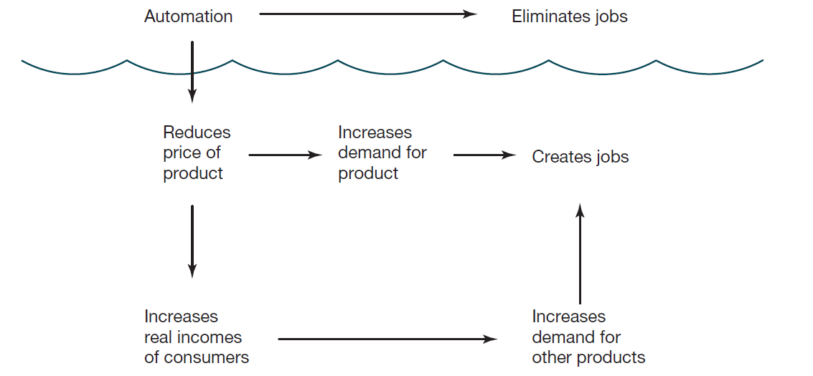
Effects of Automation
Superficially, automation eliminates jobs; but automation can also stimulate the creation of new jobs.

Slide 11
Effects of Increase in Productivity
We have used higher productivity to achieve a higher material standard of living
This is in contrast to medieval or ancient times (before modern capitalism)
In medieval or ancient times
Low caloric intake meant pace of work was slow
Work was seasonal and intermittent
Laborers resisted working if they had enough money (i.e., they weren’t consumers)
When wages rose, laborers worked less

Slide 12
Case Study: The Canceled Vacation (1 of 2)
Stuart is a software developer for Seattle start-up
Everybody works 60 hours/week
Company’s vacation policy is 3 weeks/year
Nobody takes that much
Some of Stuart’s coworkers have had zero vacation in 2+ years
Six months ago, Stuart learns his parents are moving from San Diego to Australia
He gets permission for one week’s vacation in San Diego
Doesn’t tell parents

Slide 13
Case Study: The Canceled Vacation (2 of 2)
One week before vacation, supervisor asks Stuart to delay vacation
Important product update
Offers Stuart
Three weeks’ vacation next year
Round-trip airfare
Stuart agrees to request and cancels vacation to San Diego

Slide 14
Kantian/Social Contract Theory Evaluation
Stuart broke no promises and didn’t deceive anyone
Stuart was not obligated to visit his parents before they moved from San Diego to Australia
Stuart did nothing wrong

Slide 15
Act Utilitarian Evaluation (1 of 3)
Stuart had two alternatives: accept or reject supervisor’s request
Consider duration, certainty, propinquity, and purity of two alternatives
Duration
San Diego: 1 week
Australia: 3 weeks
Trip to Australia 3 times better

Slide 16
Act Utilitarian Evaluation (2 of 3)
Purity
San Diego: Will be worrying about upset boss
Australia: Realistically, will also be worrying about upset boss
Two options equivalent
Propinquity
San Diego: Next week
Australia: Next year
Trip to San Diego much better (2 times better)

Slide 17
Act Utilitarian Evaluation (3 of 3)
Certainty
San Diego: 100%
Australia: Much less certain, given history of Stuart’s manager and fact no one has ever taken 3 weeks’ vacation, say 25%
San Diego the better choice
Summary:
San Diego: 1 × 1 × 2 × 100% = 2
Australia: 3 × 1 × 1 × 25% = 0.75
San Diego the better option
Stuart made the wrong decision

Slide 18
Virtue Ethics Evaluation
Stuart demonstrated a lack of courage and a lack of consideration for himself, his coworkers, and his parents
By caving in to his boss, Stuart
let his boss get away with bad behavior
made reasonable vacations less likely for himself and for his fellow employees
deprived his parents of the pleasure of his company for at least a year
Stuart’s decision is not characteristic of a good co-worker or a good son

Slide 19
Rise of the Robots?
Some experts suggest most jobs will be taken over by machines
Artificial intelligence: Field of computer science focusing on intelligent behavior by machines
Rapid increases in microprocessor speeds have led to various successes in A I
What will happen as computers continue to increase in speed?

Slide 20
Notable Achievements in A I Since 1995 (1 of 2)
Computer-controlled minivan “drove” on freeways across U S A in 1995
I B M supercomputer Deep Blue defeated chess champion Gary Kasparov in 1997
Honda’s A S I M O android climbed and descended stairs (2000)
Electrolux introduced robotic vacuum cleaner in 2001
Five autonomous vehicles successfully completed 128-mile course in Nevada desert in 2005

Slide 21
Notable Achievements in A I Since 1995 (2 of 2)
Watson trounced two most successful human Jeopardy! champions in 2011
Google’s self-driving cars logged more than one million miles between 2009 and 2015 without an accident (caused by the car)
AlphaGo program created by Google trounced Ke Jie, world’s #1 Go player, in multiplayer match in 2017

Slide 22
Watson Wins Jeopardy! Challenge
In 2011 an A I program named Watson running on an I B M supercomputer trounced the two greatest (human) Jeopardy! champions: Ken Jennings and Brad Rutter. (A P photo/Seth Wenig)

Slide 23
Google Self-Driving Car
Between 2009 and 2015 Google self-driving cars drove more than a million miles in autonomous mode without causing a single accident. (John Green/T N S/Newscom)

Slide 24
Moral Question Related to Robotics
Is it wrong to create machines capable of making human labor obsolete?
Would intelligent robots demoralize humanity?
Is it wrong to work on an intelligent machine if it can’t be guaranteed the machine will be benevolent toward humans?
What if a malevolent human puts intelligent machines to an evil use?
How would creative computers change our ideas about intellectual property?
How will our ideas about privacy change if superfast computers constantly analyze our electronic records?

Slide 25
10.3 Workplace Changes

Slide 26
Organizational Changes
Information technology integration into firms
Automating back office functions (e.g., payroll)
Improving manufacturing
Improving communication among business units
Results
Flattened organizational structures
Eliminating transactional middlemen (supply-chain automation)

Slide 27
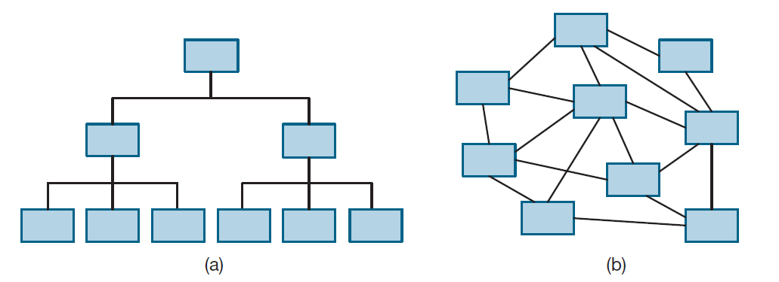
Inexpensive Interactions Lead to Flexible Information Flow
(a) When interactions are more expensive and time consuming, most information flows between people and their managers. Organizations are rigid and hierarchical. (b) When interactions become inexpensive and fast, the flow of information is much more flexible. Organizations become flatter and more dynamic.

Slide 28
Winners, Losers in the Workplace of the Future (1 of 2)
Higher Demand | Lower Demand
Software engineers-applications | Butchers
Computer support workers | Secretaries and stenographers
Software engineers-systems | Payroll clerks
Network administrators | Bank tellers
Network systems analysts | File clerks
Greater use of information technology in the workplace has increased demand for employees in certain job categories while reducing demand for employees in other categories.

Slide 29
Winners, Losers in the Workplace of the Future (2 of 2)
Higher Demand | Lower Demand
Desktop publishers | Cashiers
Database administrators | Typist
Personal and home-care aides | Pharmacists
Computer systems analysts | Bookkeepers
Medical assistants | Postal clerks
Greater use of information technology in the workplace has increased demand for employees in certain job categories while reducing demand for employees in other categories.

Slide 30
Telework
Employees work away from traditional place of work
Examples
Home office
Commuting to a tele center
Salespersons with no office
About 37% of Americans do some telework

Slide 31
Advantages of Telework
Increases productivity
Reduces absenteeism
Improves morale
Helps recruitment and retention of top employees
Saves overhead
Improves company resilience
Helps environment
Saves employees money

Slide 32
Disadvantages of Telework
Threatens managers’ control and authority
Makes face-to-face meetings with customers impossible
Sensitive information less secure
Team meetings more difficult
Teleworkers less visible
Teleworkers “out of the loop”
Isolation of teleworkers
Teleworkers work longer hours for same pay

Slide 33
The Gig Economy (1 of 3)
Companies less committed to employees
Lay-offs not taboo as they once were
Companies hiring more subcontractors and temporary employees
Saves money on benefits
Makes it easier to downsize

Slide 34
The Gig Economy (2 of 3)
Some start-ups make money by connecting people who want a service with people willing to provide that service
Gig economy: Service workers making a living by completing short-term jobs for clients
Examples
Uber, Lyft: Connect riders and drivers
Instacart: Grocery delivery service
Airbnb: Connect travelers and those with accommodations

Slide 35
The Gig Economy (3 of 3)
Proponents say workers gain independence, flexibility
Critics say these are last-resort jobs and competition among workers drives down wages
Robert Reich: “The big money goes to the corporations that own the software. The scraps go to the on-demand workers.”
Uber and Lyft drivers filed lawsuits to be classified as employees

Slide 36
Gig Workers: Caught in the Middle?
Employee | Driver for a Ride-sharing App | Independent Conctractor
Does not set own working hours | Sets own working hours | Sets own working hours
Work assigned by employer | Only feasible way to find customers is through app | Advertises to find work
Employer sets wages | Earnings set by app | Sets own fees for services
Entitled to minimum wage | Not entitled to minimum wage | Not entitled to minimum wage
Pays only employee’s portion of Social Security taxes | Pays both employee’s and employer’s portions of Social Security taxes | Pays both employee’s and employer’s portion of Social Security taxes
Can get fired | Can be taken off list of providers | Cannot be fired
Eligible for unemployment insurance | Not eligible for unemployment insurance | Not eligible for unemployment insurance
Can unionize | Courts must determine if drivers can unionize | Cannot unionize
Comparing a driver for a ride-sharing app with a traditional employee and a traditional independent contractor.

Slide 37
Monitoring (1 of 2)
Two-thirds of companies monitor Internet use of their employees
Other examples of monitoring
Video surveillance
Monitoring keyboard activity
Monitoring time spent on phone
Monitoring emails
Purpose: Identify inappropriate use of company resources
Can also detect illegal activities

Slide 38
Monitoring (2 of 2)
Other uses of monitoring
Gauge productivity
Improve productivity
Improve security; i.e., in schools
Evidence shows that monitoring…
Makes employees more focused on work
Reduces job satisfaction

Slide 39
Multinational Teams
Software development teams in India since 1980s
Advantages of multinational teams
Company has people on duty more hours per day
Cost savings
Disadvantage of multinational teams
Poorer infrastructure in less developed countries

Slide 40
10.4 Globalization

Slide 41
Globalization Basics
Globalization: Process of creating a worldwide network of businesses and markets
Globalization causes a greater mobility of goods, services, and capital around the world
Globalization made possible through rapidly decreasing cost of information technology

Slide 42
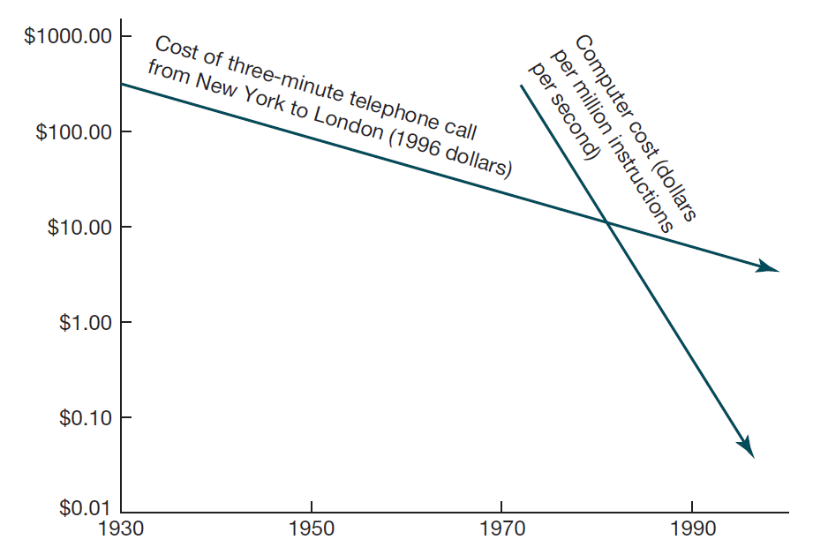
I T Improvements Led to Global Enterprises
Dramatic declines in the cost of computing and communications made global enterprises feasible by the mid-1990s.

Slide 43
Arguments for Globalization
Increases competition
People in poorer countries deserve jobs, too
It is a tried-and-true route for a poor country to become prosperous
Global jobs reduce unrest and increase stability

Slide 44
Arguments against Globalization
Makes the United States subordinate to the World Trade Organization
Forces American workers to compete with foreigners who do not get decent wages and benefits
Accelerates exodus of manufacturing and white-collar jobs from United States
Hurts workers in foreign countries, too
Example: Individual Mexican corn farmers cannot compete with large U S agribusinesses subsidized by American government

Slide 45
Dot-Com Bust Increases I T Sector Unemployment
Dot-com: Internet-related start-up company
Early 2000: stock prices of dot-coms fell sharply
Hundreds of dot-coms went out of business
Half a million high-tech jobs lost

Slide 46
Foreign Workers in the U S I T Industry
Visas allow foreigners to work inside United States
H-1B visa
Right to work up in United States to six years
Company must show no qualified Americans available
Congress still authorizes 65,000 H-1B visas per year, plus 20,000 more for foreigners with advanced degrees
L-1 visa
Allows a company to transfer a worker from an overseas facility to the United States
Workers do not need to be paid the prevailing wage
In 2017 about 78,000 foreigners employed in U S under L-1 visa

Slide 47
Foreign Competition
China is world’s number one producer of computer hardware, making 90 percent of all P Cs
I T outsourcing to India is growing rapidly
Number of college students in China increasing rapidly
A C M Collegiate Programming Contest provides evidence of global competition
No American team has placed first since 1997
From 2011-2015, only 1 of 20 teams earning gold medals was from the United States

Slide 48
10.5 The Digital Divide

Slide 49
Concept of the Digital Divide
Digital divide: Some people have access to modern information technology while others do not
Underlying assumption: people with access to telephones, computers, Internet have opportunities denied to those without access
Concept of digital divide became popular with emergence of World Wide Web

Slide 50
Evidence of the Digital Divide
Global divide
Access higher in wealthy countries
Access higher where I T infrastructure good
Access higher where literacy higher
Access higher in English-speaking countries
Access higher where it is culturally valued
Social divide
Access higher for young people
Access higher for well-educated people

Slide 51
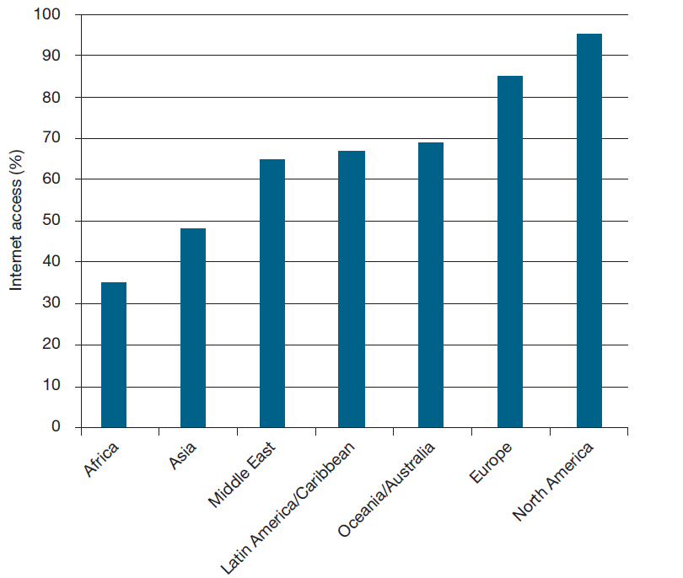
Evidence of Global Divide
Percentage of people with Internet access, by world region.

Slide 52
Models of Technological Diffusion
Technological diffusion: rate at which a new technology is assimilated
Group A: highest socioeconomic status
Group B: middle socioeconomic status
Group C: lowest socioeconomic status
Normalization model
Group A adopts first, then Group B, finally Group C
Eventually A use = B use = C use
Stratification model
Group A adopts first, then Group B, finally Group C
A use > B use > C use forever

Slide 53
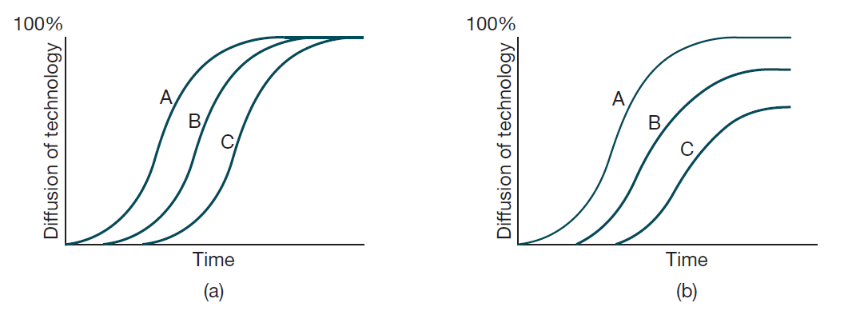
Two Models for Technological Diffusion
In both models the most advantaged group A is the first to adopt a new technology, while the least advantaged group C is the last to adopt it. (a) In the normalization model, the technology is eventually embraced by nearly everyone in all groups. (b) In the stratification model, the eventual adoption of the technology is lower for less advantaged groups.

Slide 54
Technological Optimists versus Pessimists
Technological optimists
Global adoption of information technology will follow normalization model
I T will reduce poverty in developing countries
Greater opportunities elsewhere will reduce immigration into U S
Technological pessimists
Adoption of I T will follow the stratification model, leading to a permanent condition of “haves” and “have nots”
I T will exacerbate existing inequalities between rich and poor countries and between rich and poor people within each nation
Evidence: Gap between rich and poor countries continues to grow

Slide 55
Critiques of Digital Divide
Mark Warschauer: 3 reasons why term “digital divide” not helpful
Promotes false idea that difference between “haves” and “have nots” is simply matter of access
In reality, people are somewhere on continuum, not simply in “haves” category or “have nots” category
Does lack of access lead to a less advantaged position in society, or is it actually the other way round?
Warschauer also notes that the Internet is not the pinnacle of I T development

Slide 56
Massive Open Online Courses
Rate of tuition increases at U S universities has exceeded inflation for several decades
Financing college education increasingly difficult for poorer families
Free massive open online courses (M O O Cs) promoted as a way to make higher education more affordable
Study by Community College Research Center
Students less likely to complete and do well in M O O Cs than traditional courses
M O O Cs widen achievement gap between white and black students and between those with higher G P As and those with lower G P As

Slide 57
Net Neutrality (1 of 2)
Tiered service: Charging more for high-priority routing of Internet packets
Supporters of tiered service say it is needed to support Voice-over-I P and other services
Opponents to tiered service (e.g., Google, Yahoo!) say it would hurt small start-up companies and lower innovation
Other critics believe companies controlling Internet might favor some content over other content

Slide 58
Net Neutrality (2 of 2)
Net neutrality legislation would require all Internet packets be treated the same
Opponents of proposed legislation say consumers should be able to pay more to get higher quality service; e.g., those doing video conferencing willing to pay more than those sending email
February 2015: Under President Obama, F C C issued the Open Internet Order to preserve net neutrality
December 2017: Under President Trump, F C C changed course and repealed net neutrality rules; some states introducing legislation to preserve rules

Slide 59
10.6 The “Winner-Take-All” Society

Slide 60
The Winner-Take-All Phenomenon
Winner-take-all: markets in which a few top performers have disproportionate share of wealth
Causes
I T and efficient transportation systems
Network economies
Dominance of English language
Changing business norms

Slide 61
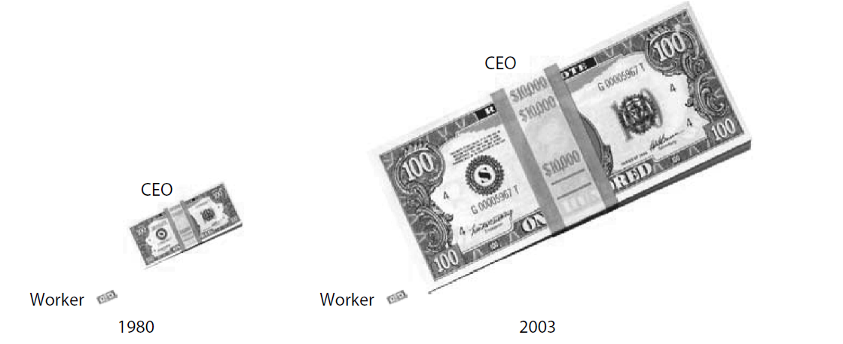
C E O Pay versus Production Worker Pay
In 1980 the average pay for a C E O at a large American company was about 40 times the pay of a production worker. By 2003 the ratio had risen to about 400 to 1.

Slide 62
Winner-Take-All Effect in Professional Sports
P G A Tour Statistics, 2016-17 Season
Metric | Dustin Johnson | Justin Rose | Miguel Angel Carballo
Driving distance (yards) | 315 | 301 | 288
Driving accuracy (%) | 57.0 | 58.3 | 63.6
Greens in regulation (%) | 69.5 | 68.1 | 64.9
Putts per green in regulation | 1.76 | 1.77 | 1.80
Winnings per tournament entered | $436,610 | $235,850 | $8,483
Comparison of personal statistics of P G A Tour professionals Dustin Johnson, Justin Rose, and Miguel Angel Carballo for the 2016-17 season.

Slide 63
Reducing Winner-Take-All Effects
Limit number of hours that stores remain open
Businesses form cooperative agreements to reduce positional arms races
Example: salary caps on pro sports teams
More progressive tax structures
Campaign finance reform

Slide 64
Summary
Automation
Results in job gains as well as job losses
Widespread unemployment has not occurred in countries where it is used the most
Will developments in A I change pattern and result in massive job losses?
Productivity has more than doubled since World War
Standard work week roughly the same
Has led to an increase in standard of living
Globalization has impacted the I T sphere, not just manufacturing
Concept of “digital divide” dividing world into technological “haves” and “have nots” is too simplistic
I T and other factors are causing “winner-take-all” effects

Slide 65

Copyright
This work is protected by United States copyright laws and is provided solely for the use of instructors in teaching their courses and assessing student learning. Dissemination or sale of any part of this work (including on the World Wide Web) will destroy the integrity of the work and is not permitted. The work and materials from it should never be made available to students except by instructors using the accompanying text in their classes. All recipients of this work are expected to abide by these restrictions and to honor the intended pedagogical purposes and the needs of other instructors who rely on these materials.

